Slide 1

Analytics for Hotel Management
GROUP 7
Phyllis Yen (U2110949L)
Khoo Yu Zhen (U2110948J)
Tan Yi Hui, Brenda (U2110207C)
Grace Lim Wan Yu (U2010635G)
Brennan Tay Yu Zhe (U2110523D)
Notes:
Present to Management on how to solve their Business Problem

Slide 2
BUSINESS PROBLEMS
Yu Zhen
There is a dire need for hotel to improve their ability to anticipate guest arrivals by utilizing forecasting models to predict potential cancellations and forecast demand. Thereby, hotels can optimize their assets and revenue streams to their fullest potential.
HIGH OPEX
LOW STAFF RETENTION
DEMAND VARIABILITY
High fixed and variable costs
Large amount of space and manpower required
Increasing overhead costs
Highest staff turnover in 2019, 2020 and 2021
Average of 98% of staff turnover rate
Potential travel boom as industry recovers from covid-19
Last minute cancellations

Slide 3
OPPORTUNITIES
Yu Zhen
TRAVEL BOOM
TECHNOLOGY
A compounded annual growth rate (CAGR) of 4.28% for hotel revenue over the next five years
Advanced technologies such as machine learning algorithm allows hotels to make informed decisions and optimise their revenue management strategies by inventory and manpower needs.

Slide 4

OPERA CLOUD SYSTEM
Existing Solution 1
Yu Zhen
Opera Cloud System is a cloud-based hospitality management system developed by Oracle Hospitality
Enables hotels to streamline their operations, increase efficiency, and improve guest satisfaction
The system includes modules for managing reservations, check-ins and check-outs, housekeeping, billing, and more

Slide 5



REVENUE OPTIMISING SYSTEM
Existing Solution 2
Yu Zhen
Data analytics and forecasting is used to help hotels optimize their pricing and inventory management decisions
Features such as demand forecasting, pricing optimization, and inventory management
Machine learning algorithms to analyze historical and real-time data to make pricing and inventory recommendations.
Provides personalised offers based on past reservations and suggesting a wider set of booking options

Slide 6

ADVANCED ANALYTICS
Existing Solution 3
Yu Zhen
Focuses on delivering actionable insights that help clients make informed decisions and optimise their business performance
The key benefits include improved operational efficiency, enhanced customer engagement, and increased revenue and profitability

Slide 7

Dataset 1:
HOTEL CUSTOMER

Slide 8
BACKGROUND
Phyllis
SOURCING | INTENT | CLEANING
Sourced from Kaggle Real-world data from a 4-star hotel in Lisbon, Portugal Demographic data, booking details and revenue | Identify key traits of customers Increase understanding of guests’ needs and wants Create customer segmentations | Subsetting/filtering Dropped and added columns Changed data types 22 variables

Slide 9

Hotel Customer
DATA EXPLORATION

Slide 10
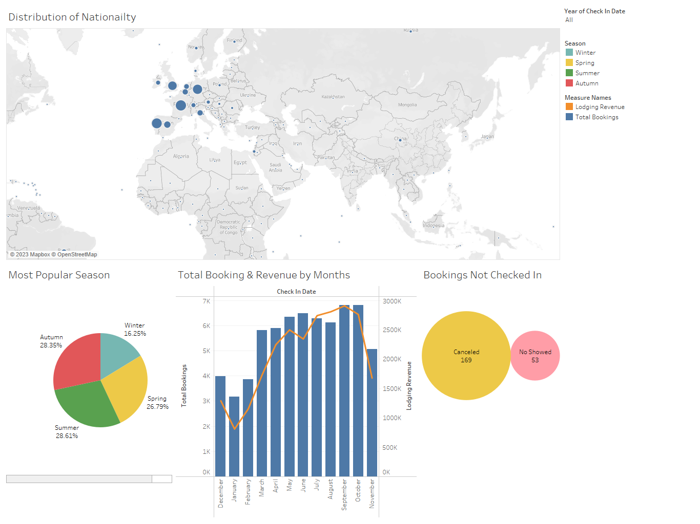
Dashboard In Tableau
Brenda
3 dashboards created with relation to booking, timing & special request, market segment
Benefits:
Provide insights about customers behaviour
Know how to market to for different segments
Increasing in more booking transactions

Slide 11

Hotel Customer
DATA MODELING

Slide 12
DATA PREPARATION
Phyllis
Random Sampling
10% of original dataset
8400 instances
Variables Selection
Numeric variables:
[AverageLeadTime], [LodgingRevenue], [OtherRevenue], [RoomNights], [NumSR]
Factor variable:
[DistributionChannel]

Slide 13
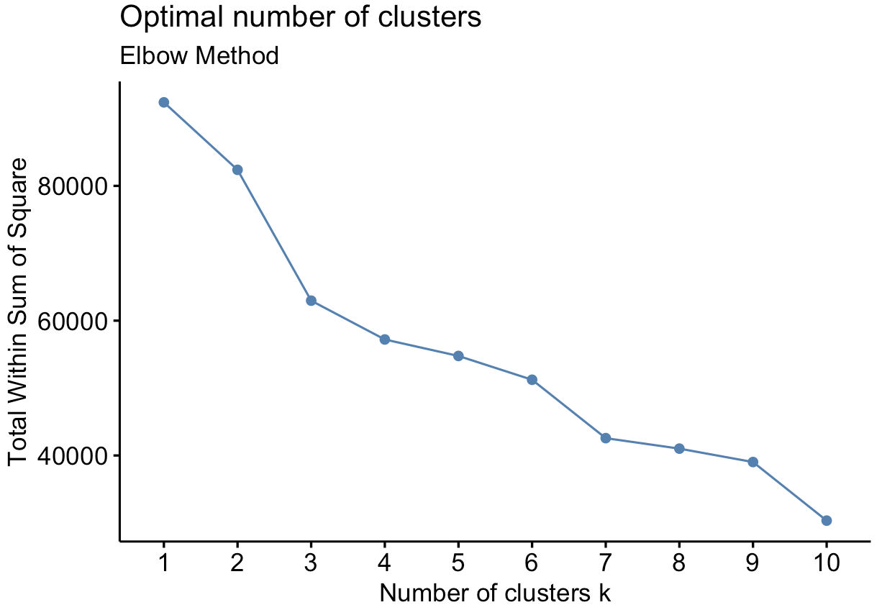
CLUSTERING
Phyllis
Optimal Clusters
Elbow method
Optimal clusters: 4
k ≥ 5 provides diminishing returns on sum of squares
However “elbow” is not obvious

Slide 14
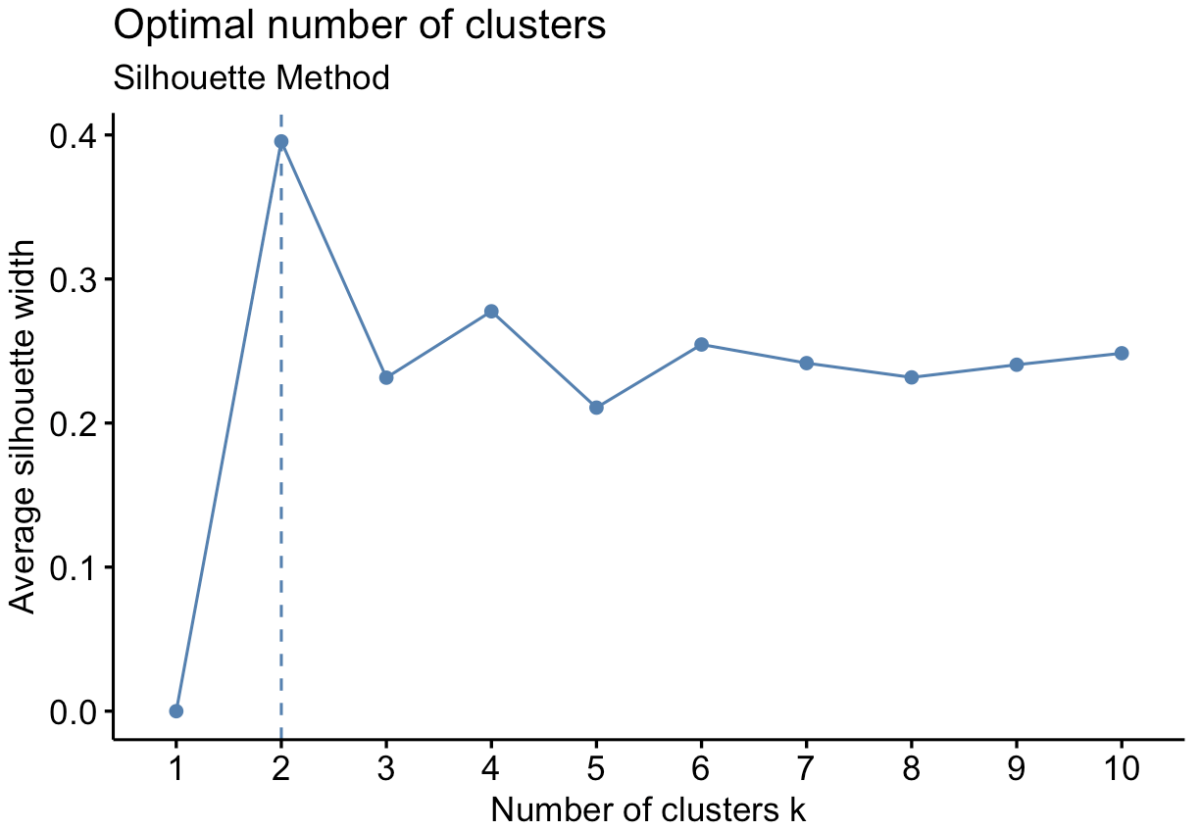
CLUSTERING
Phyllis
Optimal Clusters
Silhouette method
Pick k where silhouette coefficient is the highest
Higher coefficient = clusters more distinguished from one another
Optimal clusters: 2

Slide 15
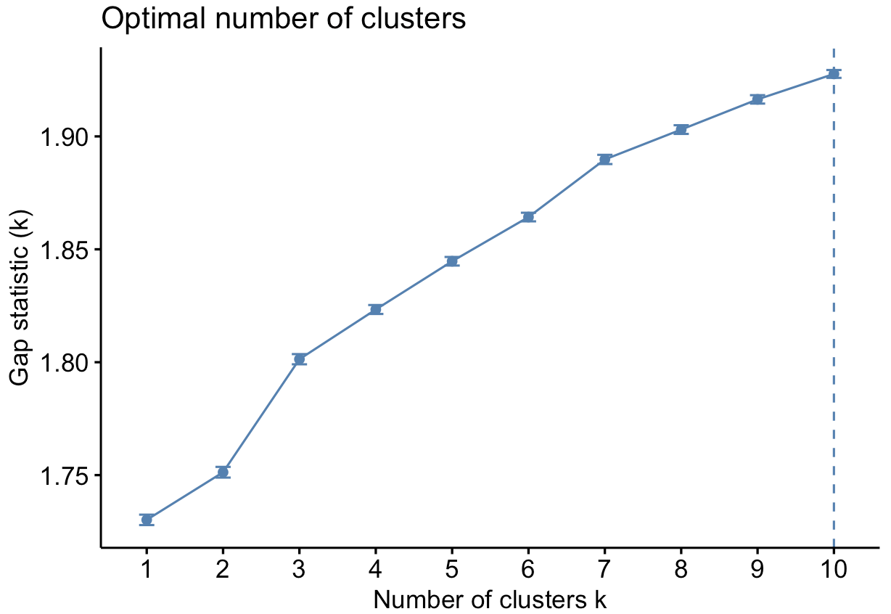
CLUSTERING
Phyllis
Optimal Clusters
Gap statistic
Compares within-cluster variation
Larger variations result in greater gap statistic
Greater gap statistic calls for more clusters

Slide 16
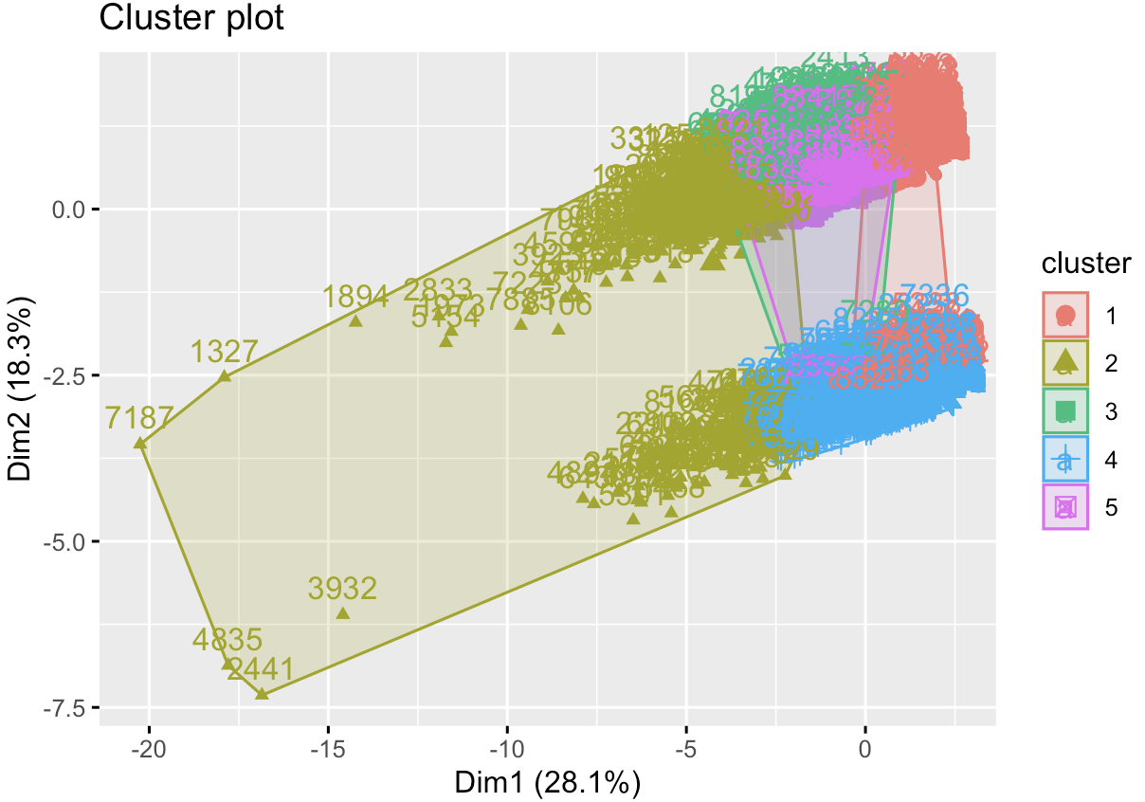
RESULTS
Phyllis
Using average k=5
Overlapping clusters
What does this mean?

Slide 17
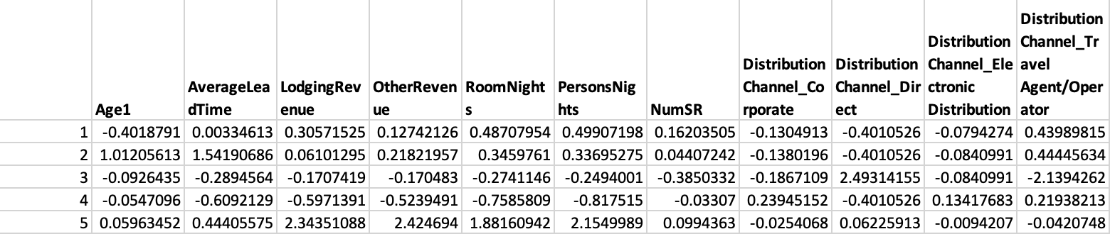
INTERPRETATION
Phyllis
Raw Cluster Centers
Cluster centers: arithmetic mean of all the data points in a cluster

Slide 18
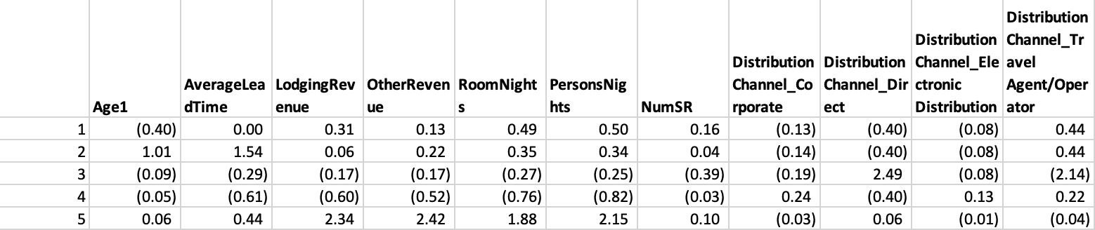
INTERPRETATION
Phyllis
Round Numbers

Slide 19
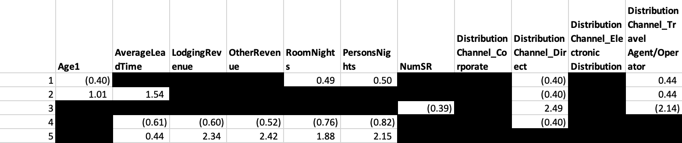
INTERPRETATION
Phyllis
Conditional Formatting
Blank out values between -0.35 and 0.35
Sufficiently close to 0 and may indicate that variable is not a defining variable used in clustering

Slide 20
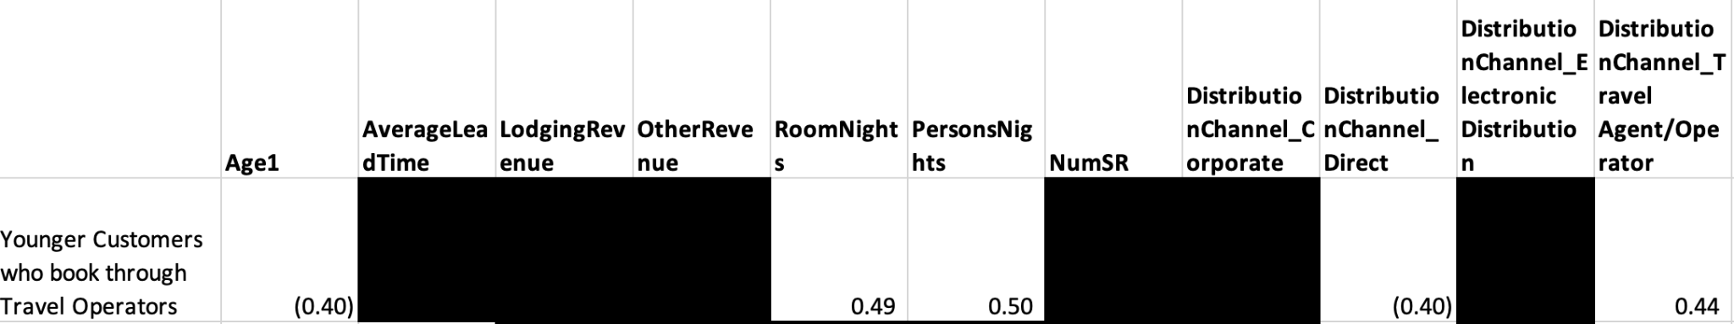
INTERPRETATION
Phyllis
Tendency to book more rooms, either due to:
More people
More nights stayed
Tendency to book for more people
Unlikely to book directly through hotelier

Slide 21
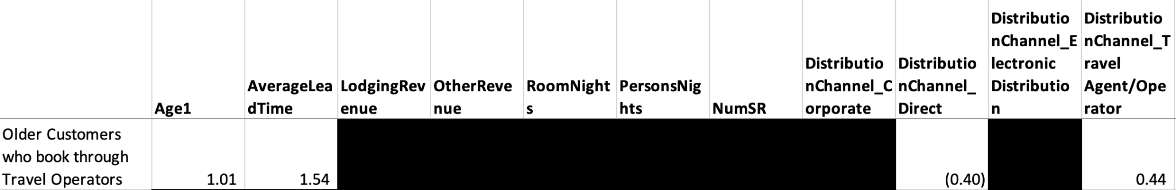
INTERPRETATION
Phyllis
High tendency to book in advance
Unlikely to book directly through hotelier

Slide 22
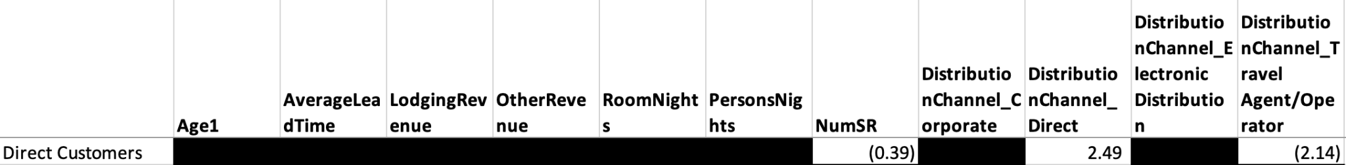
INTERPRETATION
Phyllis
Less likely to make special requests
Highly unlikely to book directly through travel operators

Slide 23
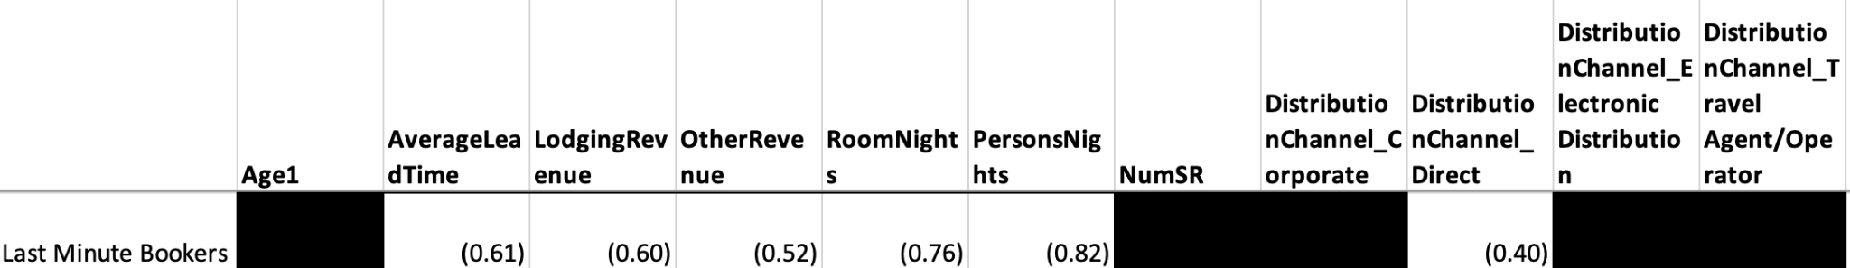
INTERPRETATION
Phyllis
Tend to spend less on lodging and other services
Require lesser rooms either due to:
Fewer occupants
Shorter duration of stay
Tendency to book for fewer people
Unlikely to book directly with hotelier

Slide 24
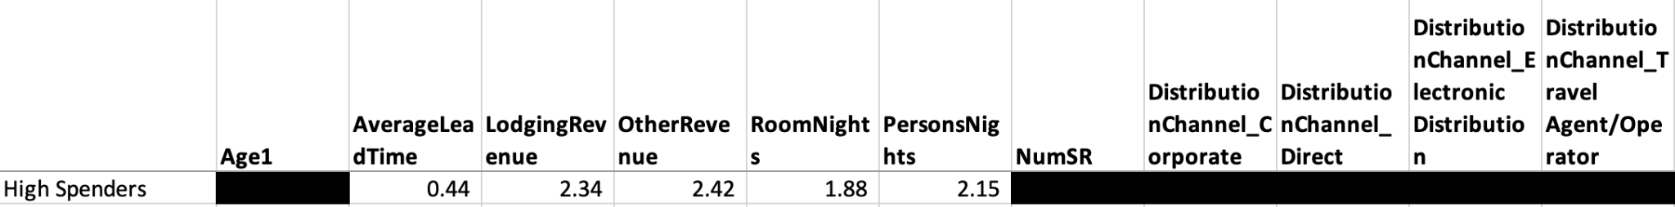
INTERPRETATION
Phyllis
Likely to book in advance
Tend to book more rooms and for more people
Such customers can come from any distribution channel

Slide 25
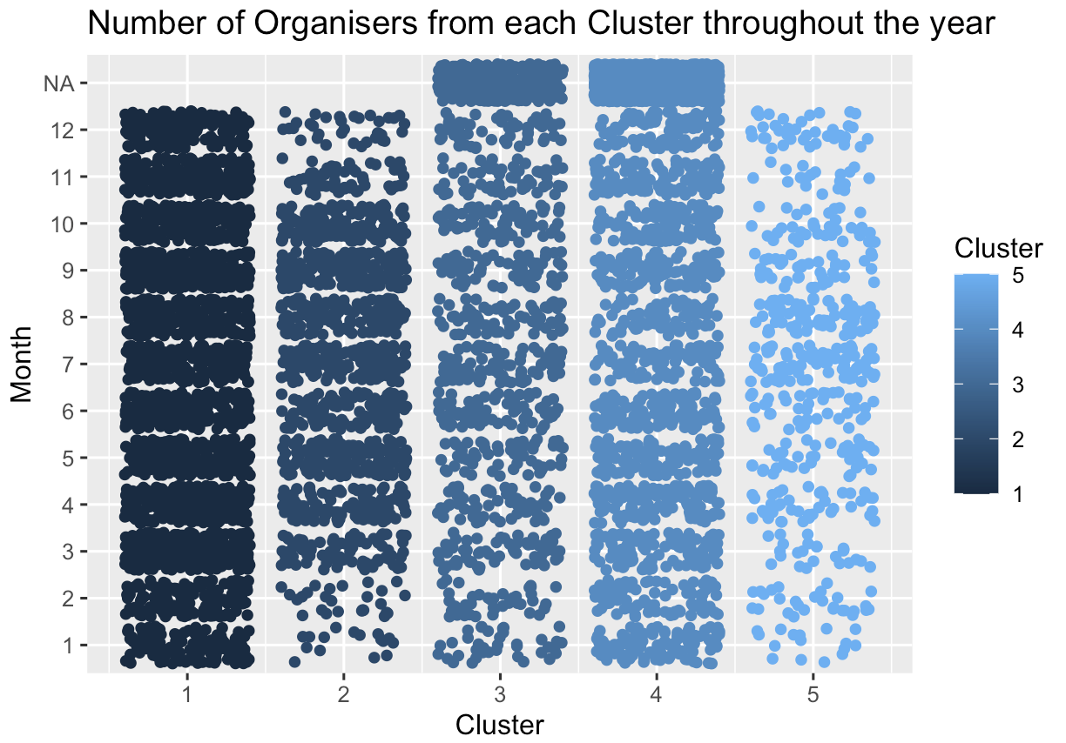
APPLICATION
Phyllis
Hotelier has fewer high spenders
Older customers from travel operators (2) visit around April to October
Visits by young customers from travel operators (1) is consistently

Slide 26
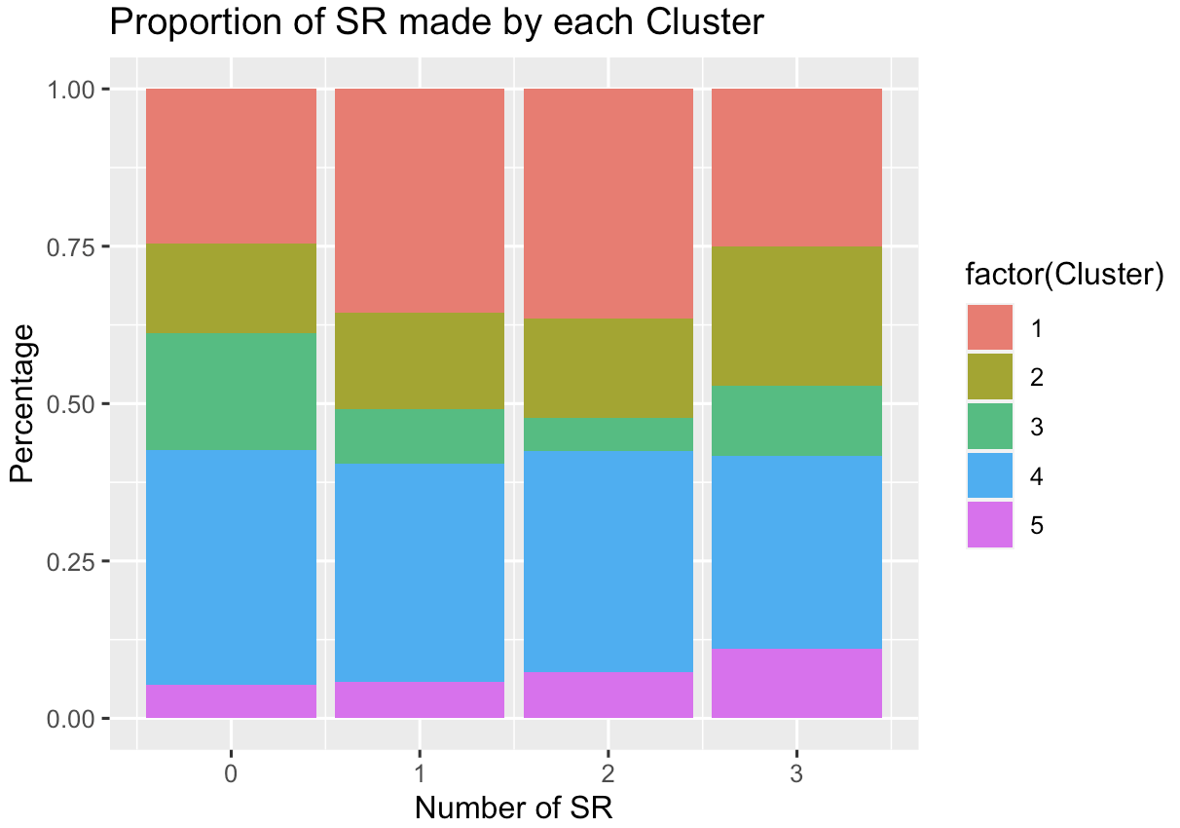
APPLICATION
Phyllis
Last minute bookers (4) have a higher tendency to make requests
High spenders (5) and older customers from travel operators (2) make fewer requests

Slide 27

Dataset 2:
HOTEL BOOKING

Slide 28
Cancellation Features
Phyllis
SOURCING | INTENT | CLEANING
Sourced from Kaggle Real-world data from a 4-star hotel in Lisbon, Portugal Demographic data, booking details, revenue and other aspects | Identify what are the features to cancellations Increase understanding of trend towards cancellation Forecast cancellations and provide possible insights/suggestions for hotels | Subsetting/filtering Dropped and added columns Changed data types 22 variables

Slide 29

Hotel Booking
DATA EXPLORATION

Slide 30
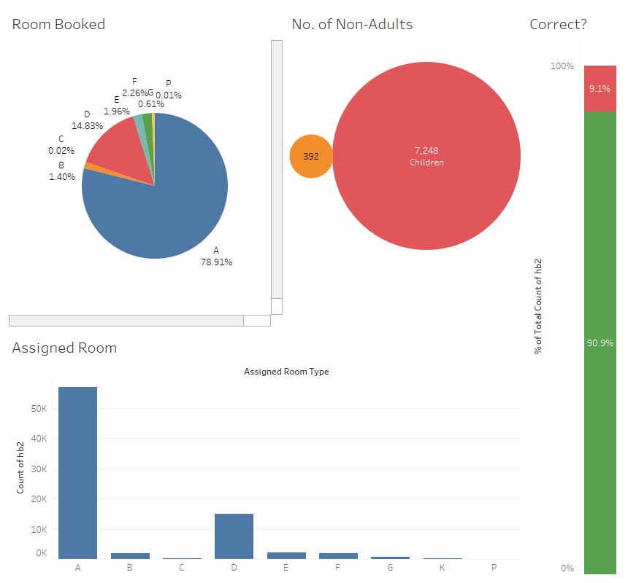
Dashboard In Tableau
Brenda
2 dashboards created with relation to room assignments and cancellation
Benefits:
Provide Hotel Manager visual insights
Better Management of hotel resources
Help to anticipate for the future

Slide 31
Customer Cancellations
Grace
Deposit Type
Proportion of cancellations within “Non-Refund” bookings was substantially cancelled
Cancellation Policies and Deposit Requirement of the hotel becomes largely relevant
Previous Booking and Cancellations
Segmentation of first-time versus repeated customers
Among repeated customers, there is an evident pattern between proportion of cancellations in previous bookings and the likelihood of cancellations
Utilising customer data to revise cancellation policies
Cancellation policies play an important role by impacting the search and booking behaviour of customers.

Slide 32
Customer Cancellations
Grace
Average Daily Rate
Cancellations on average had a higher average daily rate than non-cancellations
Enables hotels to leverage on modelling the price sensitivity threshold of customers
Lead Time
Cancellations on average had a higher lead time of 150.7 days and higher IQR of 177 days, as compared to non-cancellations, which had an average lead time of 81.9 days and IQR of 109 days
Bookings made further in advance had a higher likelihood of being cancelled
Effect of cancellation policy on lead time, which affects booking date of customers

Slide 33

Hotel Booking
DATA MODELING

Slide 34
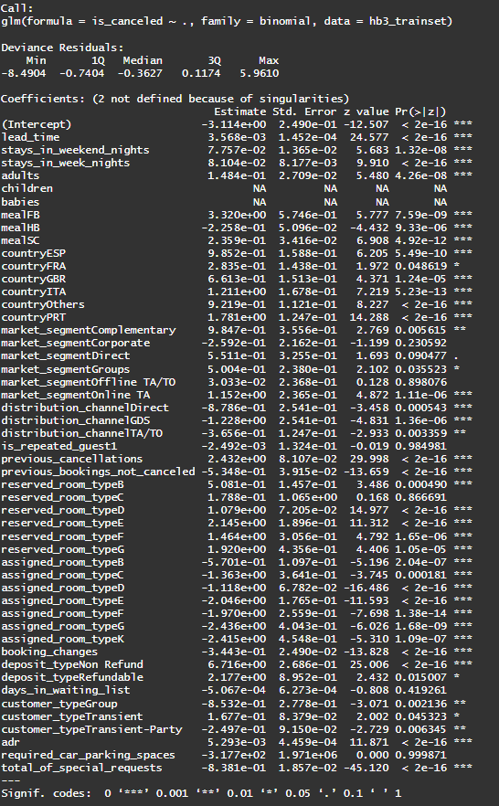
Logistic Regression Model
Grace
Lasso regression is used to identify significant variables due to difficulty in recognising significant variables
Only significant variables with a p-value of 5% or less were selected for second logistic regression
The final features that are used in logistic regression models are a total of 15 variables
Notes:
{"lead_time", "stays_in_weekend_nights", "stays_in_week_nights", "adults", "meal", "country", "distribution_channel", "previous_cancellations", "previous_bookings_not_canceled", “reserved_room_type”, "booking_changes", "deposit_type", "customer_type", "adr", "total_of_special_requests"}.

Slide 35
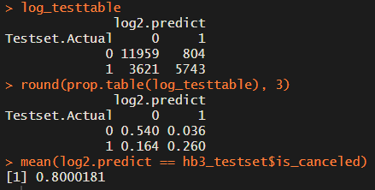
Confusion Matrix: Logistic Regression Model
Grace
False Positive (Type 1 error): Customers who did not cancel their hotel reservations but have been predicted to have been cancelled by the model
False Positive rate: 3.60%
Notes:
Before we move on, there are a few terms that we want to clarify. They are false positive, false negative and overall accuracy which can be found in logistic regression model

Slide 36
Confusion Matrix: Logistic Regression Model
Grace
False Negative (Type 2 error): Customers who have cancelled their hotel reservations have been predicted as not cancelled
False Negative rate: 16.40%
Notes:
Before we move on, there are a few terms that we want to clarify. They are false positive, false negative and overall accuracy which can be found in logistic regression model

Slide 37
Confusion Matrix: Logistic Regression Model
Grace
Overall accuracy: Proportion of the predictions that are correct
Overall Accuracy: 80.00%
Notes:
Before we move on, there are a few terms that we want to clarify. They are false positive, false negative and overall accuracy which can be found in logistic regression model and are crucial to determine which models to use

Slide 38
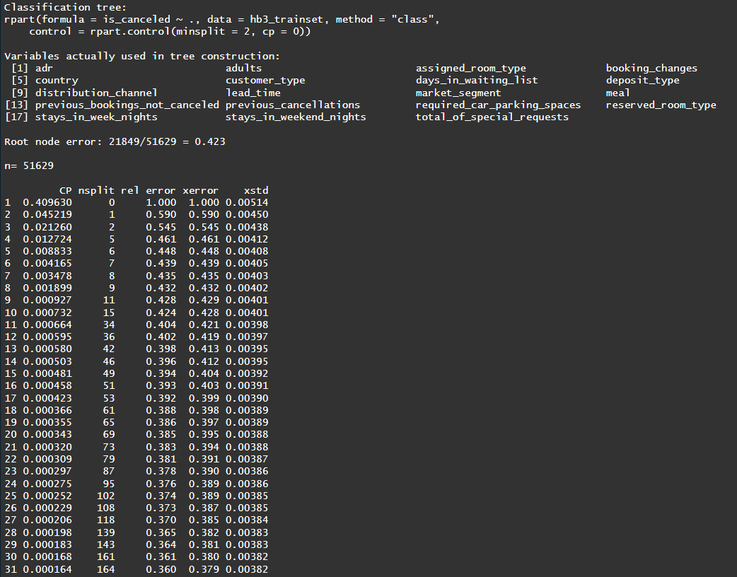
CART
Grace
CART is a tree algorithm that selects important features for prediction by choosing the best split based on purity or information gain
Computes feature importance scores based on frequency of feature use for splitting across all decision trees in an ensemble
Helps identify potential redundancies in the dataset
Pruning and cross-validation can mitigate overfitting issues

Slide 39
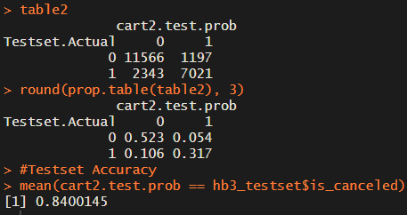
Confusion Matrix: CART
Grace
False Positive: 5.40%
False Negative: 10.60%
Overall Accuracy: 84.00%
Notes:
Before we move on, there are a few terms that we want to clarify. They are false positive, false negative and overall accuracy which can be found in logistic regression model

Slide 40
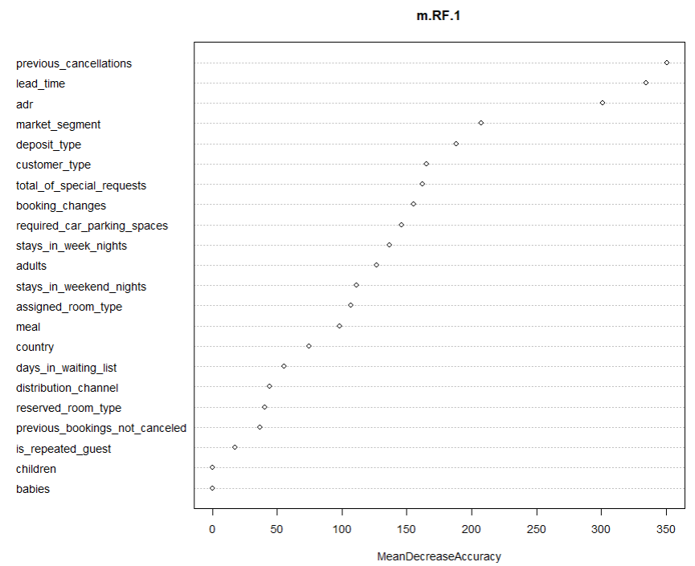
Random Forest
Grace
Used 10-fold cross validation and 500 trees to improve accuracy
Tuned 'mtry' parameter to refine accuracy further
The variable importance featured can be identified from the graph in order of significance
Notes:
Using pointer / hand gesture to explain the order of important variable

Slide 41
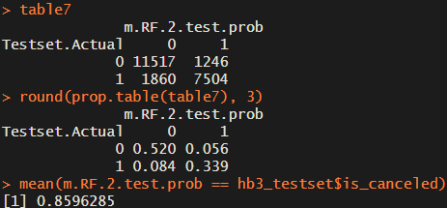
Confusion Matrix: Random Forest
Grace
False Positive: 5.60%
False Negative: 8.40%
Overall Accuracy: 85.96%
Notes:
Before we move on, there are a few terms that we want to clarify. They are false positive, false negative and overall accuracy which can be found in logistic regression model

Slide 42
Comparison between 3 models
Yu Zhen
Model | Evaluation Matrix Percentage/%
 | Overall Accuracy | False Negative Rate | False Positive Rate | F1 Score | AUC-ROC
Logistic Regression | 80.00 | 16.40 | 3.60 | 72.70 | 0.85
CART | 84.00 | 10.60 | 5.40 | 79.85 | 0.89
Random Forest | 85.95 | 8.40 | 5.60 | 82.85 | 0.91
False negative rate is crucial in determining which model to use
Overall accuracy, false negative rate, and F1 score will be used for evaluation
Notes:
We will particularly look at ……

Slide 43
Comparison between 3 models
Yu Zhen
Model | Evaluation Matrix Percentage/%
 | Overall Accuracy | False Negative Rate | False Positive Rate | F1 Score | AUC-ROC
Logistic Regression | 80.00 | 16.40 | 3.60 | 72.70 | 0.85
CART | 84.00 | 10.60 | 5.40 | 79.85 | 0.89
Random Forest | 85.95 | 8.40 | 5.60 | 82.85 | 0.91
Random Forest is the best performing model
Notes:
We will particularly look at ……

Slide 44

SOLUTIONS

Slide 45
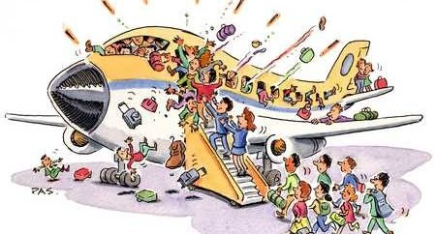


Overbooking
Brennan
Accepting more reservations than there is available inventory
Increase in operating capacity
Loss of reputation
Negative customer experience
Cost of compensation
Appropriate compensation owed

Slide 46

Overbooking
Brennan
Ideal number of overbooking = P(Cancellation)*Inventory - Buffer
Limitations of our model
Missing Data
No. of walk-in stays and overstays
Unknown cost of compensation and partnership

Slide 47
Targeted Marketing Strategies
Brennan
Understanding customer needs
Tailoring marketing efforts
Segment market -> Offer key demands
Optimizing distribution channels
74% of revenue will be generated through online sales by 2027
Transient booking vs Online travel agencies
Profit margin vs Visibility

Slide 48
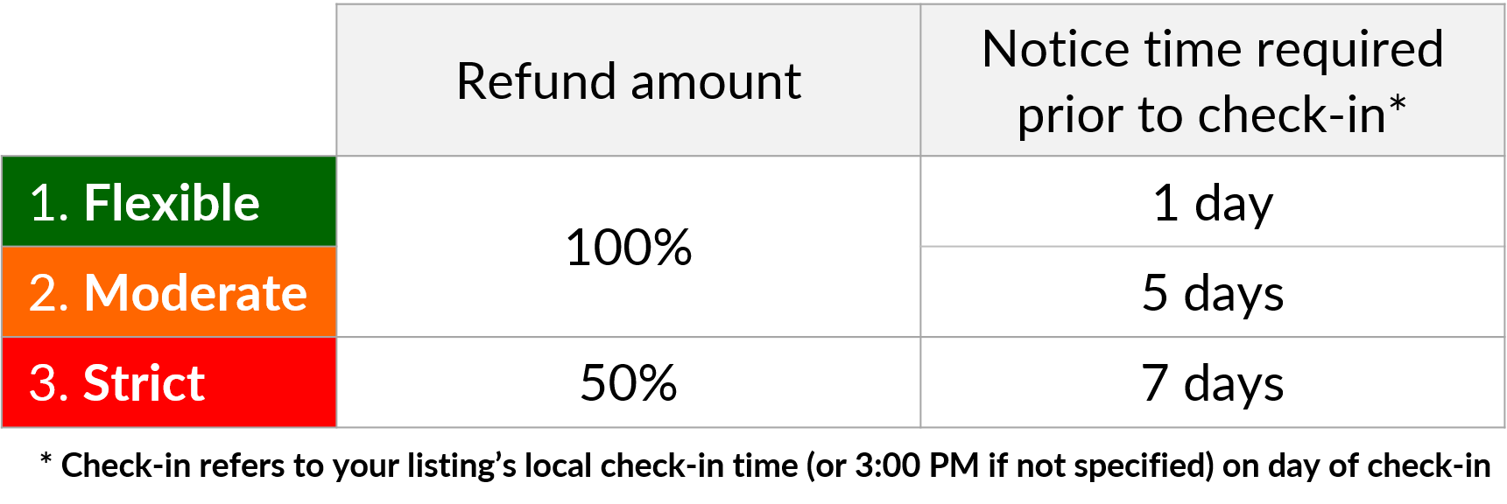
Pricing Strategies and Policies
Brennan
Discriminatory Pricing
Charging different prices based on what the hotel thinks the customer will agree to
Maximising demand and revenue
Impartial discrimination through variable importance of features
Cancellation Policies
Cancellation fees and deposits cover opportunity cost
Reduce losses
Encourage early cancellation

Slide 49
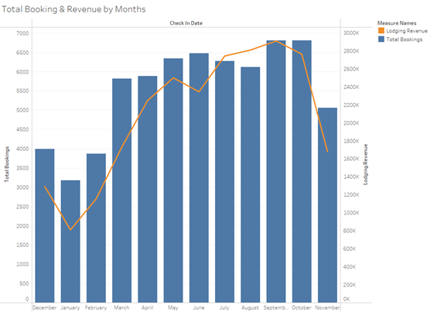
Staff Rostering
Brennan
Hospitality industry experiences seasonal demand
Temporary staffing with low retention
Staff Rostering
Classify year into peak and non-peak
Allocate shifts to part time staff for more steady employment
Recruitment
Predicting periods of higher demand allows earlier recruitment

Slide 50

THANK YOU!

